Slide 1
About mid-term examination
Thanks for the great work you have done !
If you have under 70/100, maybe you can improve your way of working:
Do you ask help from your classmates when you don’t understand something ?
Do you practice Physics quite enough ?
The work we do together is only one half of the work you should do, and the second half is to practice by yourself (which do the difference between a student just good enough to pass, and a student who is great in Physics …)
…

Slide 2
About final examination
Same rules and exercises with same level of difficulty than mid-term examination (but the whole semester will be included …)
Please to give me your numerical result as decimal value (because if not, you will give me different results, which is quite annoying because I have to calculate their decimal value …), and don’t forget your calculator without memory !
Please to use the place you have to demonstrate your results (not all the steps but the main steps to permit me to see where you did a mistake, if there is).

Slide 3
About mid-term examination
How I give a score:
I don’t follow a strict scoring scale. If your reply is wrong, I could give you points depending to what you have done …
So use the place you have in your paper to demonstrate your result !
This permits me also to see where you did a mistake: does it come from a small thoughtlessness or a big issue of misunderstanding ?
I send you the solutions tomorrow or Monday but let’s see the main difficulties in the mid-term exam.

Slide 4
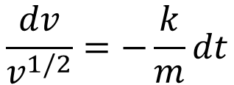

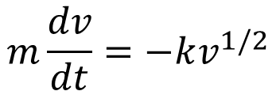
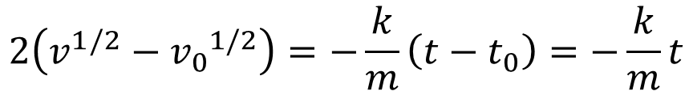
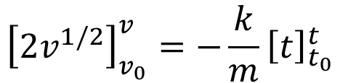
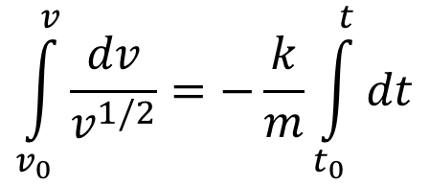
About mid-term examination
Exercise 3, you had to solve:
$$m\frac{dv}{dt}=−kv^{1/2}$$
m: mass, v:velocity
t: time
k: coefficient involved with the force exerted.
$$\frac{dv}{v^{1/2}}=−\frac{k}{m}dt$$
$$\int_{v_{0}}^{v}{\frac{dv}{v^{1/2}}}=−\frac{k}{m}\int_{t_{0}}^{t}{dt}$$
This step is not an obligation in calculating integrals but it permit to avoid mistakes …
$${\left[2v^{1/2}\right]}_{v_{0}}^{v}=−\frac{k}{m}{\left[t\right]}_{t_{0}}^{t}$$
$$2\left(v^{1/2}−{v_{0}}^{1/2}\right)=−\frac{k}{m}\left(t−t_{0}\right)=−\frac{k}{m}t$$
($t_{0}=0$ but $v_{0}≠0 !$)

Slide 5
About mid-term examination
Exercise 3, you had to solve:
$$m\frac{dv}{dt}=−kv^{1/2}$$
m: mass, v:velocity
t: time
k: coefficient involved with the force exerted.
$$\frac{dv}{v^{1/2}}=−\frac{k}{m}dt$$
This kind of integral should be easy to solve. If it is not for you, practice with a book of mathematics!
$$\int_{v_{0}}^{v}{\frac{dv}{v^{1/2}}}=−\frac{k}{m}\int_{t_{0}}^{t}{dt}$$
$${\left[2v^{1/2}\right]}_{v_{0}}^{v}=−\frac{k}{m}{\left[t\right]}_{t_{0}}^{t}$$
$$2\left(v^{1/2}−{v_{0}}^{1/2}\right)=−\frac{k}{m}\left(t−t_{0}\right)=−\frac{k}{m}t$$
($t_{0}=0$ but $v_{0}≠0 !$)

Slide 6

About mid-term examination
Exercise 3, you had to solve:
$$m\frac{dv}{dt}=−kv^{1/2}$$
m: mass, v:velocity
t: time
k: coefficient involved with the force exerted.
$$\frac{dv}{v^{1/2}}=−\frac{k}{m}dt$$
$$\int_{v_{0}}^{v}{\frac{dv}{v^{1/2}}}=−\frac{k}{m}\int_{t_{0}}^{t}{dt}$$
$${\left[2v^{1/2}\right]}_{v_{0}}^{v}=−\frac{k}{m}{\left[t\right]}_{t_{0}}^{t}$$
If you have a doubt, do the derivative:
$$\frac{d(2v^{1/2})}{dv}=2\frac{d(v^{1/2})}{dv}=v^{−1/2}=\frac{1}{v^{1/2}}$$
No mistake

Slide 7
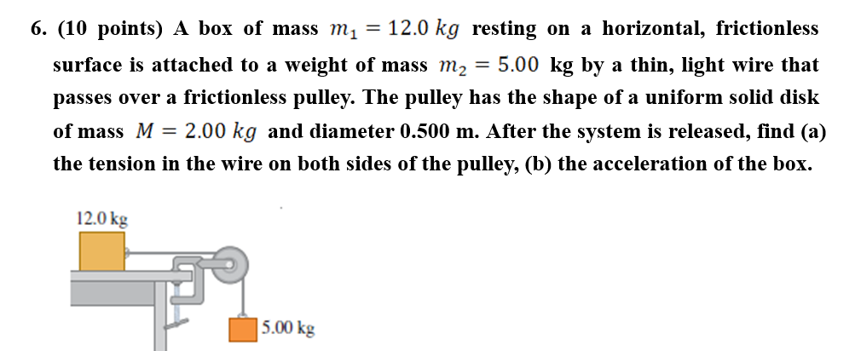
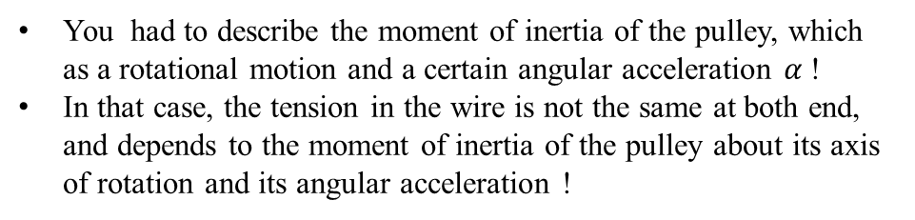
About mid-term examination
Exercise 4, you had to solve:
This exercise was a bit tricky, maybe you have seen in books, that in such exercises, the magnitude of the tension is the same at both ends of the rope.
But in that case, why the exercise give the diameter and the mass of the pulley and says it has the shape of uniform disk ?
You had to describe the moment of inertia of the pulley, which as a rotational motion and a certain angular acceleration $α$!
In that case, the tension in the wire is not the same at both end, and depends to the moment of inertia of the pulley about its axis of rotation and its angular acceleration !

Slide 8


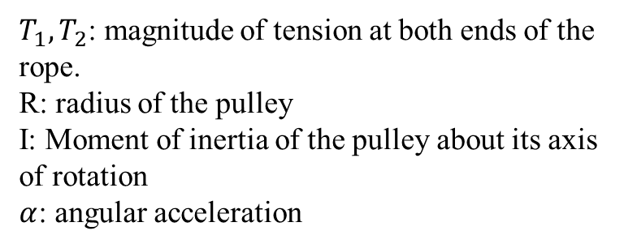
About mid-term examination
Exercise 4, you had to solve:
Using the rotational analogy of the Newton’s second law you obtain:
$$\left(T_{2}−T_{1}\right)R=Iα$$
$$T_{1}≠T_{2}$$
$T_{1}, T_{2}$: magnitude of tension at both ends of the rope.
R: radius of the pulley
I: Moment of inertia of the pulley about its axis of rotation
$α$: angular acceleration

Slide 9

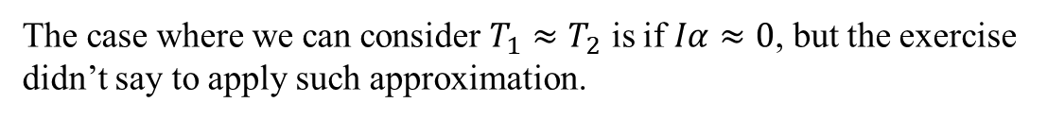
About mid-term examination
Exercise 4, you had to solve:
Using the rotational analogy of the Newton’s second law you obtain:
$\left(T_{2}−T_{1}\right)R=$ $Iα$
$$T_{1}≠T_{2}$$
The case where we can consider $T_{1}≈T_{2}$ is if $Iα≈0$, but the exercise didn’t say to apply such approximation.

Slide 10
Introduction to Wave Optics
Teacher: Paul Briard

Slide 11
Lecture 1, Lesson 1: Basics of wave Optics, light sources and interferences
Teacher: Dr. Paul Briard

Slide 12
1. Some basics of Wave Optics

Slide 13
What is an electric field ?
Electric fields are vector fields generated by (electric) charge distributions
Example:
The charges positive and negative at the surface of the plates of a capacitor.
Electric fields permits to move the electrons in an electric circuit or in a cathode tube.

Slide 14
What is a magnetic field ?
Magnetic fields are vector fields generated by the magnets and the motion of electric charges (i.e. the electric current).
Electric field is not the electric force, but they are related.
Magnetic field is not the magnetic force, but they are related.
Electric field and magnetic field are vectors and are generated by a source

Slide 15
Electric field and magnetic field
Not all the electric field and magnetic field propagate.
Magnetic field and electric field are also related to each other.
If both magnetic fields and electric fields propagate as a wave, we speak about:
An electromagnetic wave
(When an electric field propagates as a wave, there is also an associated magnetic field which propagate, and inversely. I don’t give more details about each fields, it is one of the main topics you will during next semester )

Slide 16

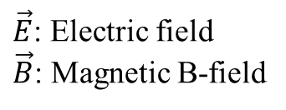

About the nature of the light
The light is both particles (named photons) and a wave.
The light is the propagation of an electromagnetic field (i.e. an electromagnetic wave)
Important characteristic parameters of a light wave are its wavelength $λ$ and its frequency (written $υ$ (Greek letter “nu”) or $f$)
rection of propagation
Propagation of an electromagnetic wave along the y-direction
$\vec{E}$: Electric field
$\vec{B}$: Magnetic B-field
$$y$$
16

Slide 17
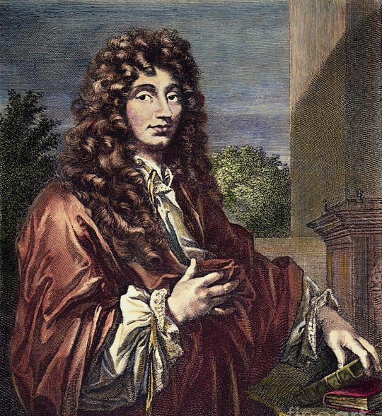
The understanding of light as a wave begins with Huygens (1629-1695)
Founder of the wave theory of the light [1]
- Particularly about the wave propagation, he also describe reflection and refraction in this framework (which will be useful later to describe diffraction) !
And many other accomplishments in astronomy and mechanics and he is the discoverer of using pendulum to regulate clock, i.e. he’s the inventor of the pendulum clock ! [2]
http://images.fineartamerica.com/images-medium-large/1-christian-huygens-granger.jpg
[1] C. Huygens “Traite de la lumiere” (Treatrise on light), English translation available here: www.gutenberg.org/files/14725/14725-h/14725-h.htm
[2] https://www.britannica.com/biography/Christiaan-Huygens
17

Slide 18
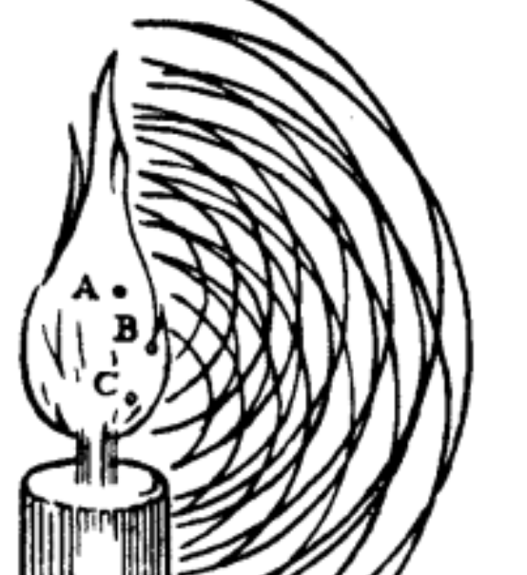
The understanding of light as a wave begins with Huygens (1629-1695)
Huygens understand the light is also wave.
He describe the Huygens principle about propagation of waves (valid for light and mechanical waves).
He don’t understand the light is a transverse wave (it is understood by Thomas Young).
A picture from [1 pp. 17], to explain wave propagation from point sources
[1] C. Huygens “Traite de la lumiere” (Treatrise on light), English translation available here: www.gutenberg.org/files/14725/14725-h/14725-h.htm
[2] https://www.britannica.com/biography/Christiaan-Huygens

Slide 19


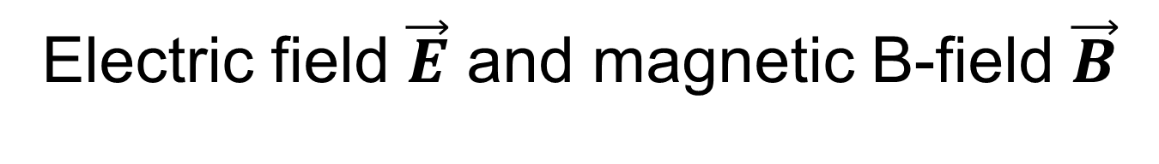


Electric field $\vec{E}$ and magnetic B-field $\vec{B}$
Both are vectors and their direction are perpendicular
Both propagates at the same velocity
Their magnitude are proportional, in vacuum:
Magnitude of
Electric field
$$B=\frac{E}{c}$$
Magnitude of
Magnetic B-field
Speed of light in vacuum
$$B=\sqrt{ε_{0}μ_{0}}E$$
Electric permittivity of vacuum
Magnetic permeability of vacuum
(Remember $B∝E$)
“$∝$” means “proportional to”

Slide 20

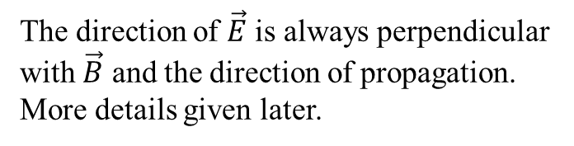


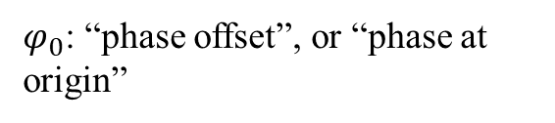




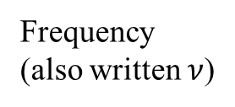
Characteristics of a sinusoidal plane wave propagating in the +x-direction
The propagation of a sinusoidal electric field wave in the +x-direction is described by:
Phase $φ\left(x,t\right)=ωt−kx+φ_{0}$
$\left|\vec{E}(x,t)\right|=E_{0}\cos\left(ωt−kx+φ_{0}\right)$
The direction of $\vec{E}$ is always perpendicular with $\vec{B}$ and the direction of propagation. More details given later.
$E_{0}$:Amplitude
Angular frequency
$$ω=2πf$$
$k$:Wave number
$$k=\frac{2π}{λ}$$
Frequency
(also written $ν$)
$φ_{0}$: “phase offset”, or “phase at origin”
In vacuum, the wavelength is $λ_{0}$:$k=\frac{2π}{λ_{0}}$

Slide 21
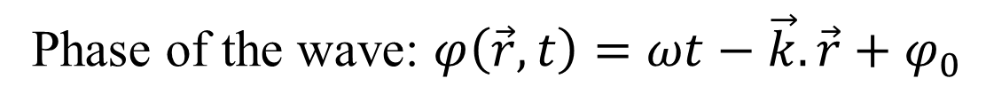
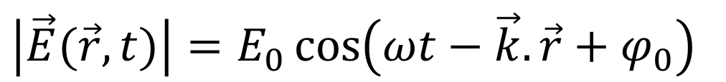
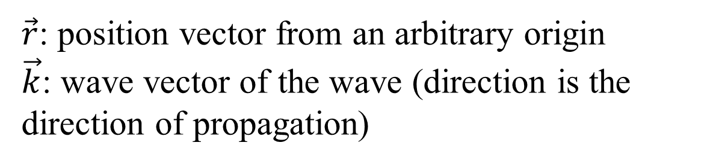
Sinusoidal plane wave propagating in any direction:
Magnitude of the electric field:
$\left|\vec{E}(\vec{r},t)\right|=E_{0}\cos\left(ωt−\vec{k}.\vec{r}+φ_{0}\right)$
Phase of the wave: $φ\left(\vec{r},t\right)=ωt−\vec{k}.\vec{r}+φ_{0}$
$\vec{r}$: position vector from an arbitrary origin
$\vec{k}$: wave vector of the wave (direction is the direction of propagation)

Slide 22
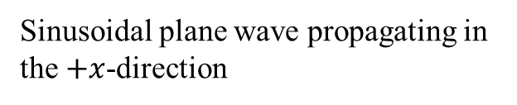
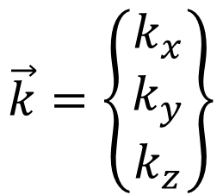


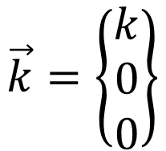
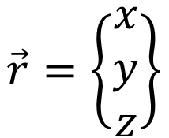
Sinusoidal plane wave propagating in any direction:
Magnitude of the electric field:
$\left|\vec{E}(\vec{r},t)\right|=E_{0}\cos\left(ωt−\vec{k}.\vec{r}+φ_{0}\right)$
$$\vec{k}=\left\{\begin{matrix}k_{x} \\ k_{y} \\ k_{z}\end{matrix}\right\}$$
$$\vec{r}=\left\{\begin{matrix}x \\ y \\ z\end{matrix}\right\}$$
$$\vec{k}=\left\{\begin{matrix}k \\ 0 \\ 0\end{matrix}\right\}$$
$$\vec{k}.\vec{r}=kx$$
If the wave vector is:
$\left|\vec{E}(\vec{r},t)\right|=E_{0}\cos\left(ωt−kx+φ_{0}\right)$
Sinusoidal plane wave propagating in the $+x$-direction

Slide 23
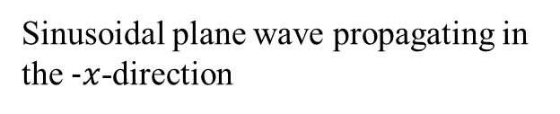


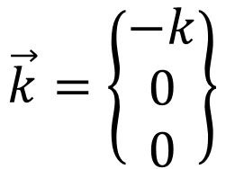
Sinusoidal plane wave propagating in any direction:
Magnitude of the electric field:
$\left|\vec{E}(\vec{r},t)\right|=E_{0}\cos\left(ωt−\vec{k}.\vec{r}+φ_{0}\right)$
$$\vec{k}=\left\{\begin{matrix}k_{x} \\ k_{y} \\ k_{z}\end{matrix}\right\}$$
$$\vec{r}=\left\{\begin{matrix}x \\ y \\ z\end{matrix}\right\}$$
$$\vec{k}=\left\{\begin{matrix}−k \\ 0 \\ 0\end{matrix}\right\}$$
$$\vec{k}.\vec{r}=−kx$$
If the wave vector is:
$\left|\vec{E}(\vec{r},t)\right|=E_{0}\cos\left(ωt+kx+φ_{0}\right)$
Sinusoidal plane wave propagating in the $−x$-direction

Slide 24
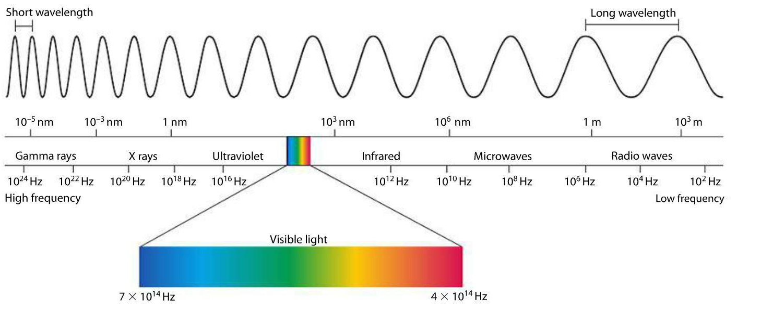


Wavelength and frequency
The electromagnetic spectrum
Decrire. Que l’on parle de light de infrared a ultraviolet. Onde electromagnetic sinon
Lumiere visible: couleurs de l’arc en ciel (rainbow)
The visible light correspond to a small range of the electromagnetic spectrum
$$≈400 nm$$
wavelength
$$≈800 nm$$

Slide 25
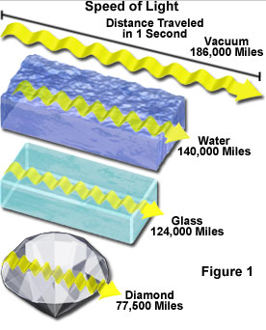

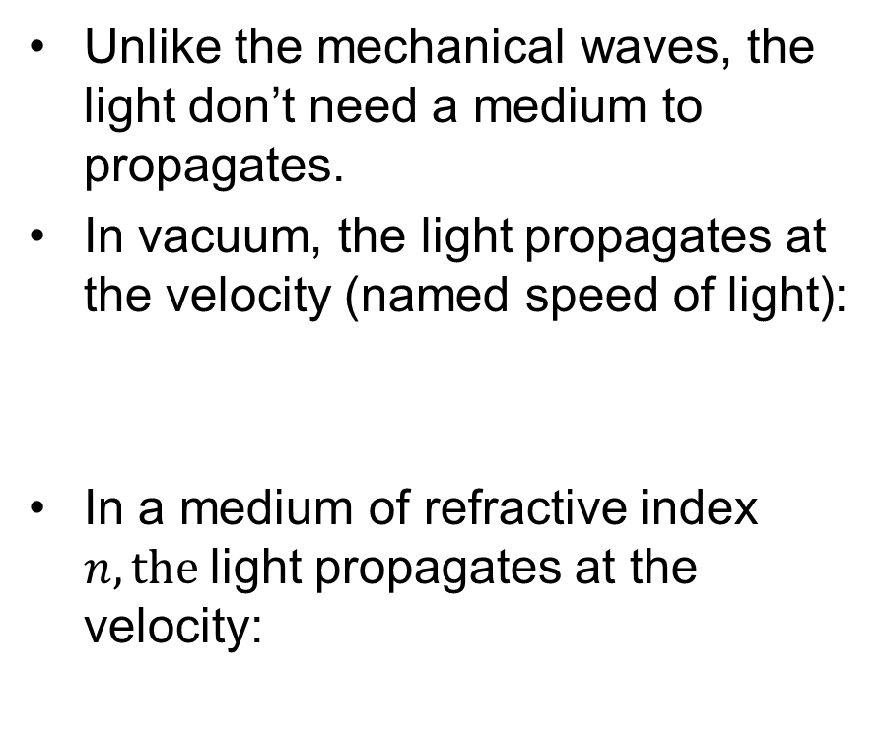

Propagation of the light
Je peux prendre exemples sur:
La Lumiere mets une seconde a venir de la lune
Elle mets 7 minutes a venir du soleil
Decrire figure de droits, pour dire que different milieu on different indices et don’t differentes vitesses de propagation
Unlike the mechanical waves, the light don’t need a medium to propagates.
In vacuum, the light propagates at the velocity (named speed of light):
In a medium of refractive index $n, the$light propagates at the velocity:
$$c≈3.{10}^{8} m/s$$
$$v=\frac{c}{n}$$
Important to remember

Slide 26
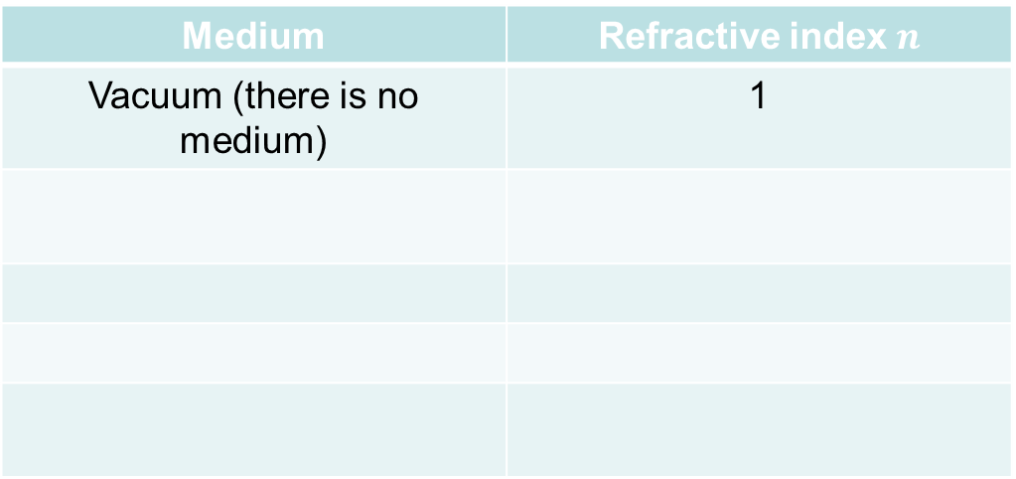
Some examples of refractive index [1]
Medium | Refractive index $n$
Vacuum (there is no medium) | 1
[1] https://refractiveindex.info/?shelf=3d&book=liquids&page=water

Slide 27

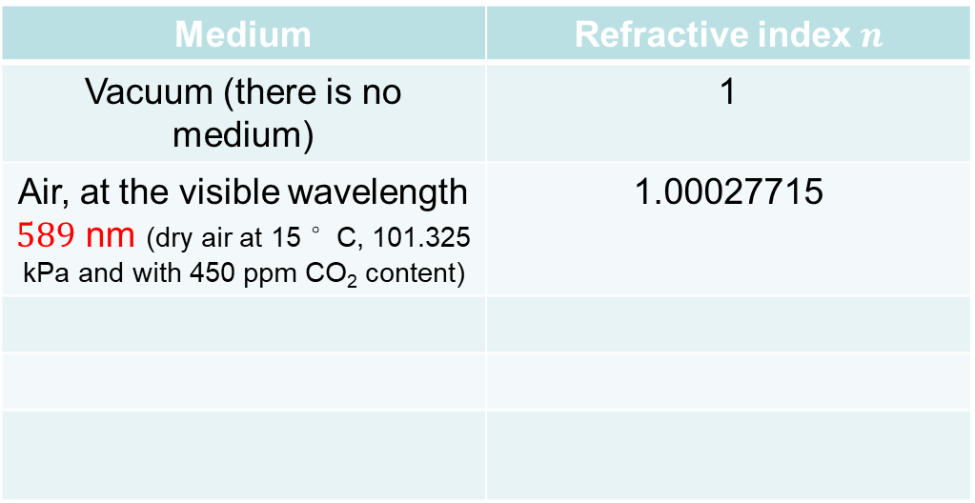
Some examples of refractive index [1]
Medium | Refractive index $n$
Vacuum (there is no medium) | 1
Air, at the visible wavelength $589$ nm (dry air at 15 °C, 101.325 kPa and with 450 ppm CO₂ content) | 1.00027715
$$n_{air}≈1$$
The refractive index depends on the wavelength

Slide 28
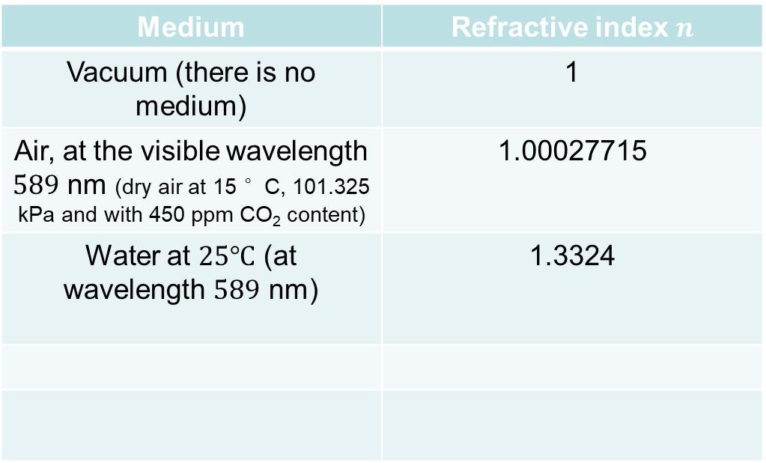
Some examples of refractive index [1]
Medium | Refractive index $n$
Vacuum (there is no medium) | 1
Air, at the visible wavelength $589$ nm (dry air at 15 °C, 101.325 kPa and with 450 ppm CO₂ content) | 1.00027715
Water at $25℃$ (at wavelength $589$ nm) | 1.3324
$$n_{air}≈1$$
[1] https://refractiveindex.info/?shelf=3d&book=liquids&page=water

Slide 29
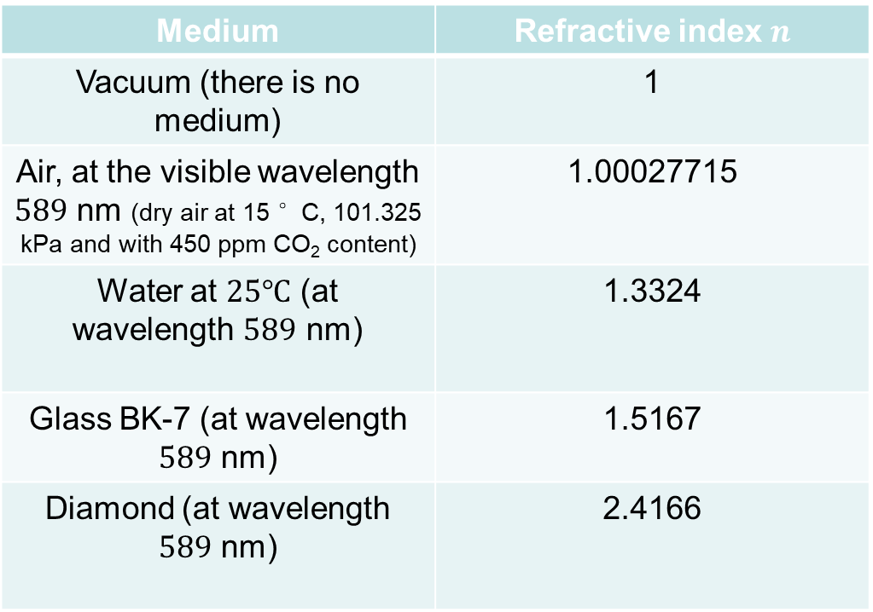
Some examples of refractive index [1]
Medium | Refractive index $n$
Vacuum (there is no medium) | 1
Air, at the visible wavelength $589$ nm (dry air at 15 °C, 101.325 kPa and with 450 ppm CO₂ content) | 1.00027715
Water at $25℃$ (at wavelength $589$ nm) | 1.3324
Glass BK-7 (at wavelength $589$ nm) | 1.5167
Diamond (at wavelength $589$ nm) | 2.4166
$$n_{air}≈1$$
[1] https://refractiveindex.info/?shelf=3d&book=liquids&page=water

Slide 30

Some examples of refractive index [1]
Medium | Refractive index $n$
Vacuum (there is no medium) | 1
Air, at the visible wavelength $589$ nm (dry air at 15 °C, 101.325 kPa and with 450 ppm CO₂ content) | 1.00027715
Water at $25℃$ (at wavelength $589$ nm) | 1.3324
Glass BK-7 (at wavelength $589$ nm) | 1.5167
Diamond (at wavelength $589$ nm) | 2.4166
Important to remember
$$n_{air}≈1$$
[1] https://refractiveindex.info/?shelf=3d&book=liquids&page=water

Slide 31



Wave vector
The wave vector $\vec{k}$ is perpendicular to the wave front (so, it describes the direction of propagation). In vacuum:
$$\left|\vec{k}\right|=k=\frac{2π}{λ_{0}}$$
$$\vec{k}$$
Wave number
Wave front
Wavelength in vacuum
Wave front: surface of constant phase

Slide 32

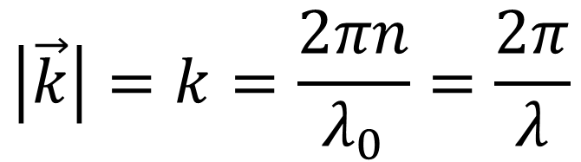
Wave vector
Wave vector $\vec{k}$, in a medium of refractive index $n$:
Refractive index of the medium of propagation
$$\left|\vec{k}\right|=k=\frac{2πn}{λ_{0}}=\frac{2π}{λ}$$
$$\vec{k}$$
Wave number
Wave front
Wavelength in vacuum
Wavelength in the medium
Important to remember

Slide 33
Point source of light
The flame of a candle, the filament in light bulb, or the sun, are extended sources of light.
An extended source can be seen as a sum of point sources
The light from a point source has spherical wave fronts.
A point source in an extended source

Slide 34






Wave vector and point source
For a point light source, at the distance $r$ from the source, the position vector from the source $\vec{r}$ has the same direction than the wave vector:
$$\vec{k}.\vec{r}=kr$$
$$\vec{r}$$
P
$$\vec{k}$$
$$S$$
Point source
Spherical wave front (of radius $r$)

Slide 35
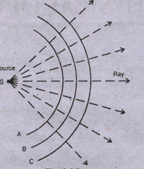
Direction of propagation of homogeneous waves: Some examples
The direction of propagation of homogeneous waves is perpendicular to the wave fronts.
The main wave fronts are plane wave fronts, spherical wave fronts, and cylindrical wave fronts (there could be other kind of wave fronts)
Light ray
Light rays
https://en.wikipedia.org/wiki/Plane_wave
Plane wave fronts
https://notes.tyrocity.com/wp-content/uploads/Spherical-Wave-front.png
Cylindrical wave fronts (here from a linear source)
Spherical wave fronts from a source point

Slide 36

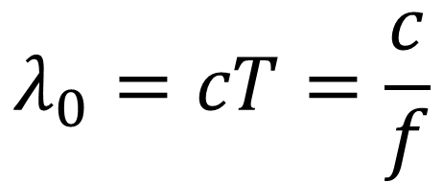

Relations between the main parameters of a sinusoidal light wave
In vacuum (refractive index $n=1$),
Period
$$λ_{0}=cT=\frac{c}{f}$$
Wavelength
in vacuum
Frequency (written $f$ or $υ$)
Light speed in vacuum

Slide 37



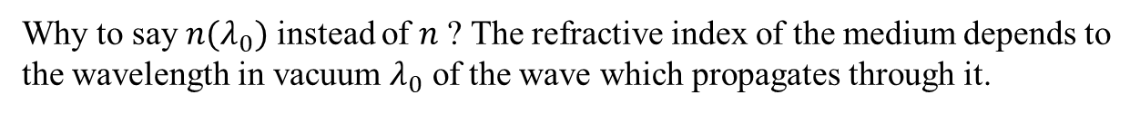

Relations between the main parameters of a sinusoidal light wave
Wavelength in vacuum
In a medium of refractive index $n$,
$$λ=\frac{λ_{0}}{n(λ_{0})}$$
$$λ=vT=\frac{c}{n(λ_{0})}T=\frac{c}{n(λ_{0})f}$$
Wavelength in the medium
Light speed in the medium
Important to remember
Why to say $n(λ_{0})$ instead of $n$ ? The refractive index of the medium depends to the wavelength in vacuum $λ_{0}$ of the wave which propagates through it.
The speed of light in the medium is then strictly:
$$v=\frac{c}{n\left(λ_{0}\right)}$$
Now you know it, so we can just use “$n$” instead of $n(λ_{0})$.

Slide 38
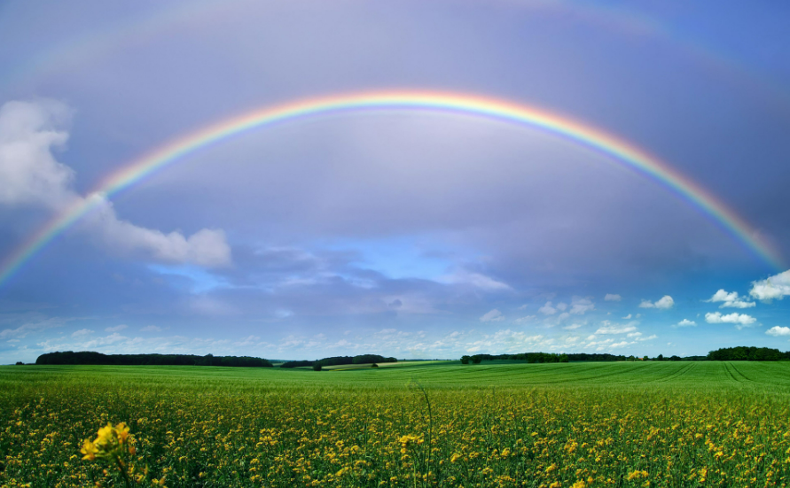
Question (2 minutes):
Why do we see rainbows (as shown on the figure, there are two rainbows) in the sky with the different “rainbow colors” ?

Slide 39
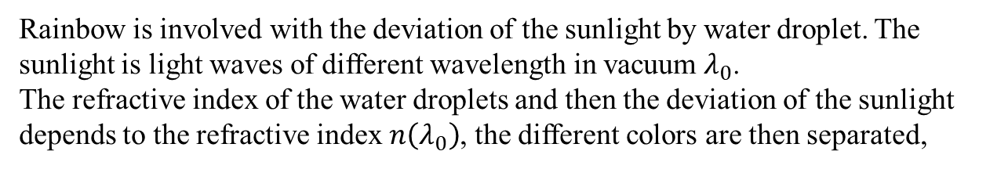
Question:
Rainbow is involved with the deviation of the sunlight by water droplet. The sunlight is light waves of different wavelength in vacuum $λ_{0}$.
The refractive index of the water droplets and then the deviation of the sunlight depends to the refractive index $n\left(λ_{0}\right)$, the different colors are then separated,

Slide 40
End of lecture 1

